Slide 1


The mechanics of compromising low entropy RSA keys
Austin Allshouse
Notes:
Hello DEF CON,
Thank you for attending...
My name is Austin Allshouse, I am a research scientist at BitSight.
As part of my job, I do a lot of surveys…
I am going to walk you the low-level details... of how to do one study I did recently that involved compromising RSA keys through discovery of shared prime factors.

Slide 2
This talk is about...
Nominally:
Recovering private keys from a subset of vulnerable RSA certificates
Functionally:
Calculating shared factors across large batches of integers
“...using our scalable GCD algorithm for shared factors...”
“...batch GCD on RSA keys, using a custom distributed version...”
“...we adapted the batch GCD implementation…”
Notes:
While this talk is nominally about how to compromise a specific subset of vulnerable RSA keys, it is really functionally about a scalable method to calculate shared factors across large batches of integers; because that is the mechanism by which we are going to do it.
There has been a lot of past research on this topic, and many of the researchers have simply attested that they “build a custom, scalable distributed batch GCD implementation” to factor keys collected from the Internet, but many of these studies have been light on implementation details, so this talk is going to walk you through what distributed batch GCD means, and how to implement it yourself to break some RSA keys.

Slide 3
Hello darkness, my old friend...
p x q = n
random prime
random prime
public modulus
Notes:
I’m not going to give an RSA recap, but…
The first step when producing an RSA key pair…
The security of RSA is dependent upon it is not tractable to factor the public modulus back into the constituent primes
...and the secrecy of these primes is critical to the security of the private key.

Slide 4
When primes are reused...
p x q₁ = n₁; p x q₂ = n₂
gcd(n₁, n₂) = p
n₁/p = q₁; n₂/p = q₂
Notes:
But while large integer factorization is a computationally difficult problem, fast and efficient methods do exist..
This means that if any two RSA keys happen to choose one of the same primes when generating keys…
In theory, this should never happen, as the number of potential primes to choose from is so mind-bogglingly large, that it will never happen by chance.

Slide 5
Select past research...
2012
2016
2018
“Mining your Ps and Qs...”
“Weaks Keys Remain Widespread...”
“Reaping and breaking keys at scale…”
@DEF CON 26
- Discovered widespread prime reuse in certificates
- Demonstrated flaws in pseudorandom number generation
- Greatly expanded scope of keys evaluated (81 million)
- Detail a method of parallelizing modulus factorization
- Industrialized key acquisition and factoring on a massive scale from diverse sources (hundreds of millions)
Notes:
However, back almost a decade ago, two research teams actually found… … and they were able to attribute this phenomenon to flawed implementations in pseudorandom number generators seeding the key generation process.
This has been revisited with larger key batches, culminated with DEF CON 26- Ku-del-ski security industrialized the process for variety of weak implementations, including the shared prime factor vulnerability I am discussing today.
So the question really is… if some RSA keys share primes, and can be compromised by finding shared factors across them, how do you calculate GCD across hundreds of millions of keys?

Slide 6
GCD circa 300 BC (Euclid)
Prime products: (7 x 67) = 469; (11 x 61) = 671; (7 x 59) = 413; (17 x 53) = 901
from itertools import combinations
products = [469, 671, 413, 901]
def gcd(a, b):
if a == 0:
return b
return gcd(b%a, a)
for pair in combinations(products, 2):
print(f'gcd{pair} = {gcd(*pair)}')
gcd(469, 671) = 1
gcd(469, 413) = 7
gcd(469, 901) = 1
gcd(671, 413) = 1
gcd(671, 901) = 1
gcd(413, 901) = 1
Notes:
To answer that question: we need to go back -- oldest known algorithms -- Euclidian algorithm --
It works by recursively calculating the remainders…
In this trivially small example on the slide comprised of 4 products of prime numbers…
While this slide is using small integers of illustrative purposes, these integers could just as easily be real RSA moduli...
The Euclidean algorithm is fast and efficient, but because you have to do pairwise combinations, attempting to calculate the GCD across hundreds of millions of keys could potentially require hundreds of quadrillions of iterations of the algorithm, which is simply not scalable.

Slide 7
Batch GCD circa 2004 AD (Bernstein)
Product Tree
Building:
child1 * child2 = parent
Remainder Tree
Decomposing:
parent mod child² = child
Remainder Tree Leaves
gcd( remainder/product, product ) = shared_factor
Notes:
Skipping back ahead over 2000 years, a cryptographer named Bernstein published... Like many problems in computer science, it uses an intermediate tree data structure to bypass the requirement of calculating every pairwise combination of numbers.
It calculating the products of pairs of numbers in the batch and repeating this process up successive levels of the tree until at the root of the tree represents the cumulative product of all the numbers in the batch.
Decomposes that product tree back into remainders by calculating the remainder of each parent node with respect to the square of its child node until the leaves of the tree represent the remainders of each integer in the batch with respect to the cumulative product of the whole batch. A final GCD step computed on each leaf remainder will reveal if that particular integer shares a factor with any other integer in the batch.
This is a very similar approach to the Euclidian algorithm -- distinction being that the shared factors are being discovered with respect to the cumulative product -- effective approach for RSA key factorization -- shared factors are relatively rare -- any factor output by this method will be one of the primes used for key generation -- less likely to be some sort of composite value
This may be difficult to visualize just from a description, so I’m going to walk you through an explicit example.

Slide 8
Product Tree
Prime products: (7 x 67) = 469; (11 x 61) = 671; (7 x 59) = 413; (17 x 53) = 901
117103588987
314699
372113
469
671
413
901
Notes:
In this example, we are using the same prime products as before which contain two products with a shared factor of 7. Building the product tree is merely a process of pairing off the integers and calculating their products at each level, until we get to the cumulative product of the batch represented in green.

Slide 9
Remainder Tree
Prime products: (7 x 67) = 469; (11 x 61) = 671; (7 x 59) = 413; (17 x 53) = 901
117103588987
117103588987 mod (314699)² = 18068128386
117103588987 mod (372113)² = 117103588987
18068128386 mod (469)² = 91924
18068128386 mod (671)² = 407297
117103588987 mod (413)² = 124313
117103588987 mod (901)² = 482936
gcd(91924 / 469, 469)
= 7
gcd(407297 / 671, 671)
= 1
gcd(124313 / 413, 413)
= 7
gcd(482936 / 901, 901)
= 1
Notes:
After the product tree has been formed, the remainder if each parent node is calculated with respect to the square of its child node.
When the bottom of the tree is reached, the GCD of calculated between the resulting remainder and the modulus, and if this value is not 1, it means it shares a factor with another modulus in the batch. In our same example, the two shared factors of 7 are output just the same as using the pairwise Euclidian implementation.
While this batch implementation is very fast, it raises a new challenge in that the product trees can potentially get very, very large. Such a tree of 150 million 2048 bit RSA moduli would be roughly a terabyte which can be difficult to manage.

Slide 10
Parallelization - 150 million 2048-bit moduli
Batch Count | 1 | 5
Batch Size | 150 million | 30 million
Product Tree Size | > 1 terabyte | ~ 180 gigabytes
Tree Permutations | 1 | 20
Notes:
Say you don’t have a machine with a terabyte of memory, there’s actually a pretty straightforward way to make this calculation more manageable. Instead of making one very large product tree, you make a few smaller ones. Breaking that 150 million batch up into 5 smaller batches will produce product trees that are roughly 180 gigabytes which can be quite a bit more manageable to process on a single machine.
There is a major downside to breaking the tree up into smaller batches, however, and that is in order to get coverage of shared factors across all batches, the remainder trees must be calculated with respect to each other tree, which requires permuting the trees. This is less efficient, but in practice may actually be faster because all of the arithmetic is being done on smaller numbers, and no bottleneck exists when trying to calculate arithmetic on huge integers at the root of a massive, monolithic product tree.

Slide 11
Tree permutation
Batch 1: (7 x 67) = 469; (11 x 61) = 671; (7 x 59) = 413; (17 x 53) = 901
Batch 2: (17 x 47) = 799; (23 x 43) = 989; (29 x 41) = 1189; (23 x 37) = 851
(117103588987 x 799566308029) = 93632084303281054076623
117103588987
799566308029
314699
372113
790211
1011839
469
671
413
901
799
989
1189
851
gcd(36113 / 469, 469)
= 7
gcd(50996 / 671, 671)
= 1
gcd(101185 / 413, 413)
= 7
gcd(505461 / 901, 901)
= 17
gcd(258077 / 799, 799)
= 17
gcd(727904 / 989, 989)
= 23
gcd(1223481 / 1189, 1189)
= 1
gcd(665482 / 851, 851)
= 23
Notes:
To walk you through an explicit example again, here we have two batches of prime products.
The first batch is the same as before and shares a prime factor of 7, the second batch has a shared factor of 23, and then across both batches there is a shared factor of 17. When calculating the remainders for each tree against the cumulative product of both trees, all of these shared factors fall out at the bottom. The permutation of the trees is important because otherwise the 17 factor which is shared across both batches would not have been discovered.
By calculating the product trees, and permuting the remainder trees in this way, the calculation of shared factors across a huge number of integers can be broken down into batches and parallelized across any number of machines without any outrageous memory requirements. The sizes of the trees and the number of batches can be tailored to the compute and memory resources available.

Slide 12
Implementation tech stack
gob
product
EBS
Language | golang
Arithmetic | github.com/ncw/gmp
Storage | S3 / EBS
Serialization | gob
Concurrency | goroutines
Orchestration | bash
goroutines/gmp
product
product
product
product
product
modulus
modulus
modulus
modulus
modulus
S3
Notes:
Here is an example architecture that I used to factor 86 million RSA keys used only commodity hardware and no specialized software.
The factorization code was written in Go, and that is just implementing the product and remainder trees described earlier. The actual arithmetic was calculated using the native C GNU Multiprecision Library since it is allegedly quite a bit more performant than its Go counterpart. RSA moduli were read from S3 and product tree levels stored to EBS using Go’s native gob library for serialization. Concurrency in calculating tree levels used goroutines and the orchestration of tree permutations was simple a shell script. No specialized software, no big data frameworks needed.

Slide 13
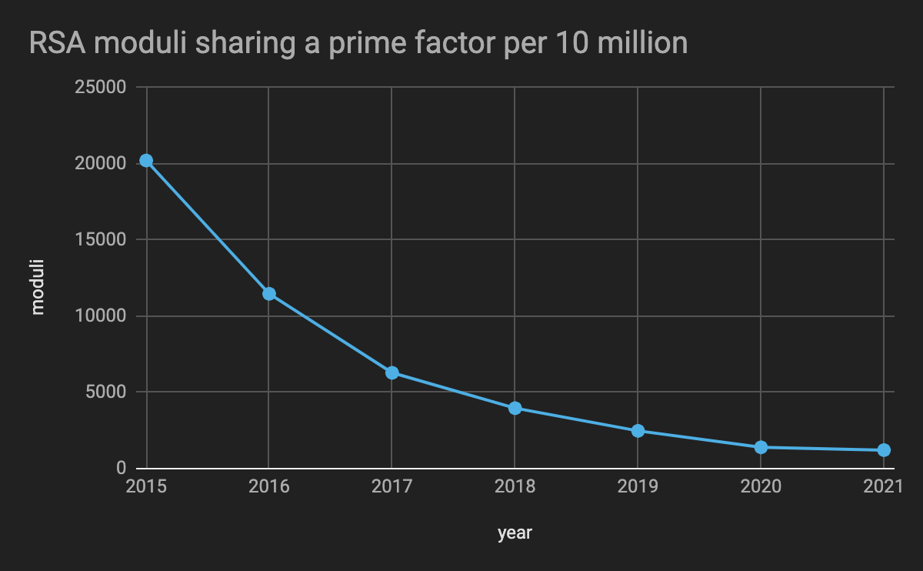
Notes:
I used that architecture to factor about 86 million keys from certificates collected from the Internet over a period about 3 months, and found some interesting results. Less than 50,000 of those keys were able to be compromised due to sharing a prime factor. This was a much lower number than I was expecting, and much lower than had been reported in prior years.
As a sanity check, I went back and collected samples of keys dating back 6 years and discovered that sure enough; the prevalence of this type of vulnerable key has decreased dramatically over the years. The chart on this slide represents the number of keys that could be factored in a random sample of 10 million keys collected in a given year, based on sharing a prime factor with another key in its same 10 million key sample.
I think the dramatic decline observed here is a real testament to the impact of prior research which appears to have gotten vendors to address this problem.

Slide 14
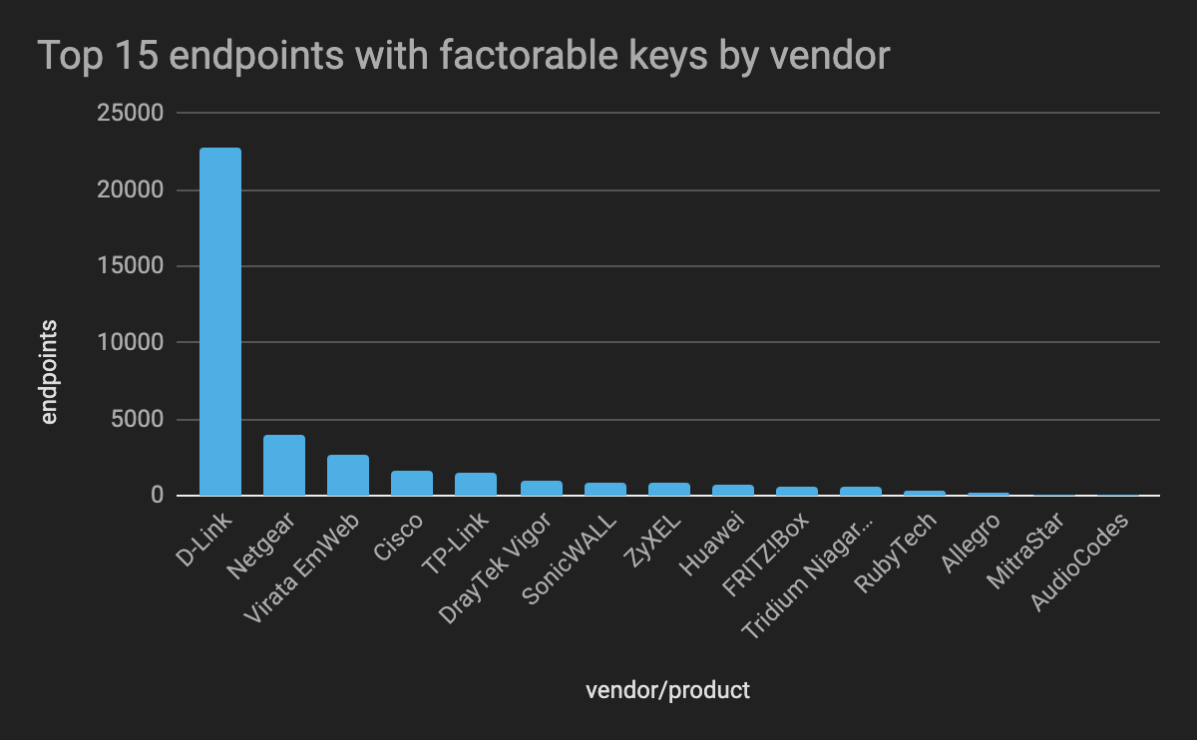
Notes:
Of the keys that were still vulnerable, they almost exclusively appeared in networking devices and embedded systems.
But the question remains, if this issue has largely been remediated, and is trending downward, why are there still so many vulnerable keys on the Internet? Well, reviewing the certificate validity lifetimes of the vulnerable keys provides some insight into that.

Slide 15
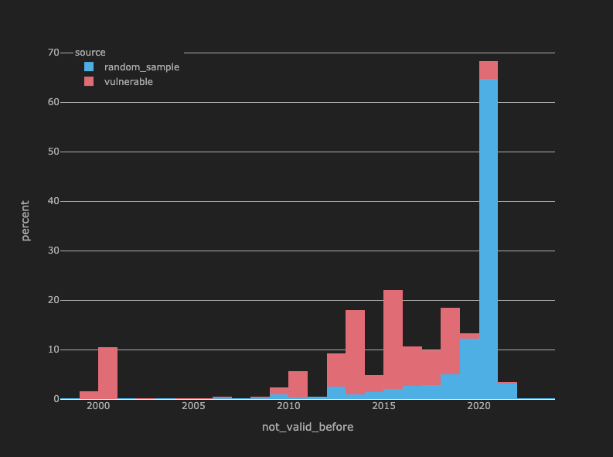
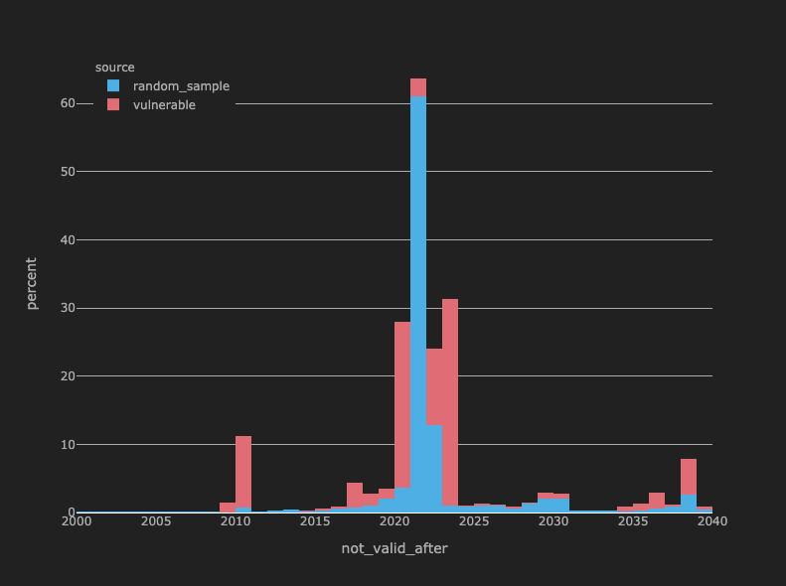
Old and busted certificates
Notes:
The charts here show a histogram of validity dates of vulnerable certificates compared to to a random sample of certificates from the Internet. The long tail of “not valid before” dates hint that perhaps the certificates are just really old devices. And the “not_valid_after” dates, over 10% of which expired over a decade ago reinforce this fact. Many of the vulnerable certificates likely represent just really old networking equipment, that is likely lost in a closet somewhere yet still connected to the Internet.
Out of roughly 150 million total keys analyzed, only a single vulnerable key was signed by a trusted, third party certificate authority; every single other vulnerable key was from a self-signed on an internal CA-signed certificate. This suggests that the likely culprit of of many of these keys are devices that are automatically generating certificates. This is reinforced somewhat by the absurdly long validity durations present in the second chart which are likely configured as a convenience by the device vendors, which of course is out of line with best practices.

Slide 16
At risk...
Vendor auto-generated device certificates
Old, unmanaged devices (i.e. shadow IT)
Industry Sectors | Relative Likelihood of Vulnerability
Finance, Insurance, Legal | 1x
Business Services, Engineering | 3x
Government, Manufacturing, Hospitality | 4x
Defense, Entertainment, Real Estate | 6x
Utilities | 10x
Notes:
When reviewing the organizations hosting these vulnerable devices --- the trends are generally what you would expect.
Organizations in industries that typically have mature security programs such as Financial Services were the least likely to be hosting vulnerable devices
Industries notorious for lax practices, such as Utilities were more than 10 times as likely to be hosting a vulnerable device than their low-risk industry counterparts.

Slide 17
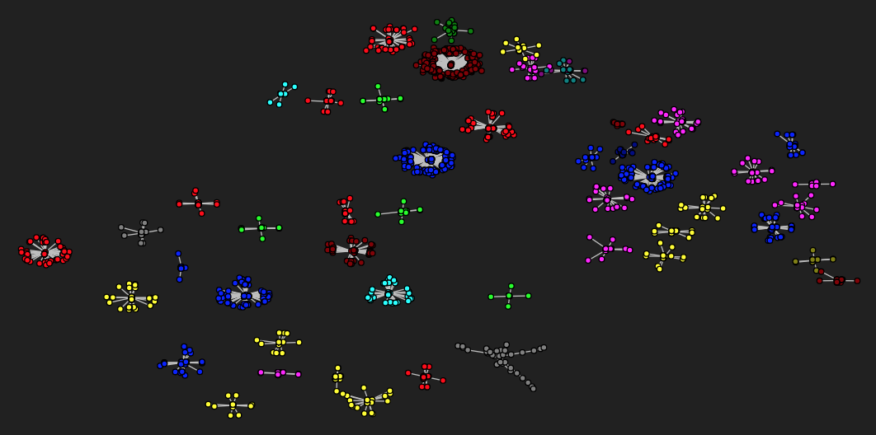
Shared primes are device-specific; disjoint
Notes:
Saved for last, importance: This chart represents the relationships between vulnerable prime values, where an edge exists between two primes if they appeared in the same RSA modulus. The coloring represents the product family the primes appeared in, for example, one color is Huawei switches, one is D-Link routers, etc.
It becomes very obvious that the relationships between primes are mostly disjoint between different products.
Important because if they are disjoint, attempting to find shared factors across product families is a fruitless exercise: as the vendor-specific random number generation flaws are only going to create prime collision within their given product family.
The implication of this is that you do not really need a “big data” approach of collecting a huge corpus of keys to compromise keys via this method. Small collections of keys, specific to a given networking device or an embedded systems product are as likely to be found vulnerable as massive collections of random keys harvested from the Internet.
Much of the analysis of these flawed keys has focused on keys collected from the public-facing Internet -- opportunities to find additional vulnerable products and keys in devices that are typically not exposed directly from the Internet

Slide 18
In conclusion...
Vendors have largely addressed this vulnerability
doesn’t matter if old keys are still in use
Isolated to self-signed/non-public CA signed certificates
Massive scale of key acquisition is not necessary
limit batches to keys from specific devices
Reference Implementation (Python)
https://github.com/austinallshouse/defcon29-key-factorization-reference
Notes:
Almost a decade after discovery, there still exist a fairly large number of devices on the Internet whose keys are factorable due to shared primes, but this seems to primarily be the result of really old devices, and not necessarily new vulnerable products.
culprits -> auto-generated certificates from networking equipment, so maybe don’t trust those certificates.
Don’t need specialized software, or a massive corpus of keys-- small targeted collections of keys from specific networking or embedded systems products can potentially yield results.
Finally, I published a reference implementation of the distributable batch GCD method described in this talk at the link on this slide
It will demonstrate the successful factorization of a small batch of actual RSA moduli.
Just for illustrative purposes, written in Python-- slow, scale it by translated into compiled.
And I will close with that. Thank you for attending my talk and enjoy the rest of DEF CON 29.

